Slide 1
Lecture 11: How to Write Formal Letters
Note: Sharing or editing the video/audio using any software or website is strongly prohibited

Slide 2
What is a formal letter?
Usually written to people you don’t know
E.g. Written to:
  Complain
  Apply for a job
  Reply to a formal letter you have received

Slide 3
Style / Language
Not personal
Need to give information in the shortest, clearest way possible
Use language that is business-like but clear

Slide 4
Structure
Every piece of writing should have:
  Beginning
  Middle
  End

Slide 5
In Formal Letters...
Beginning = introduction
Middle = main body
End = conclusion

Slide 6
Writing & Organising a Formal Letter
Brainstorm
Plan layout
Decide on greeting and ending
Organise ideas
Plan introduction, main body & conclusion
Proof read, edit and redraft

Slide 7
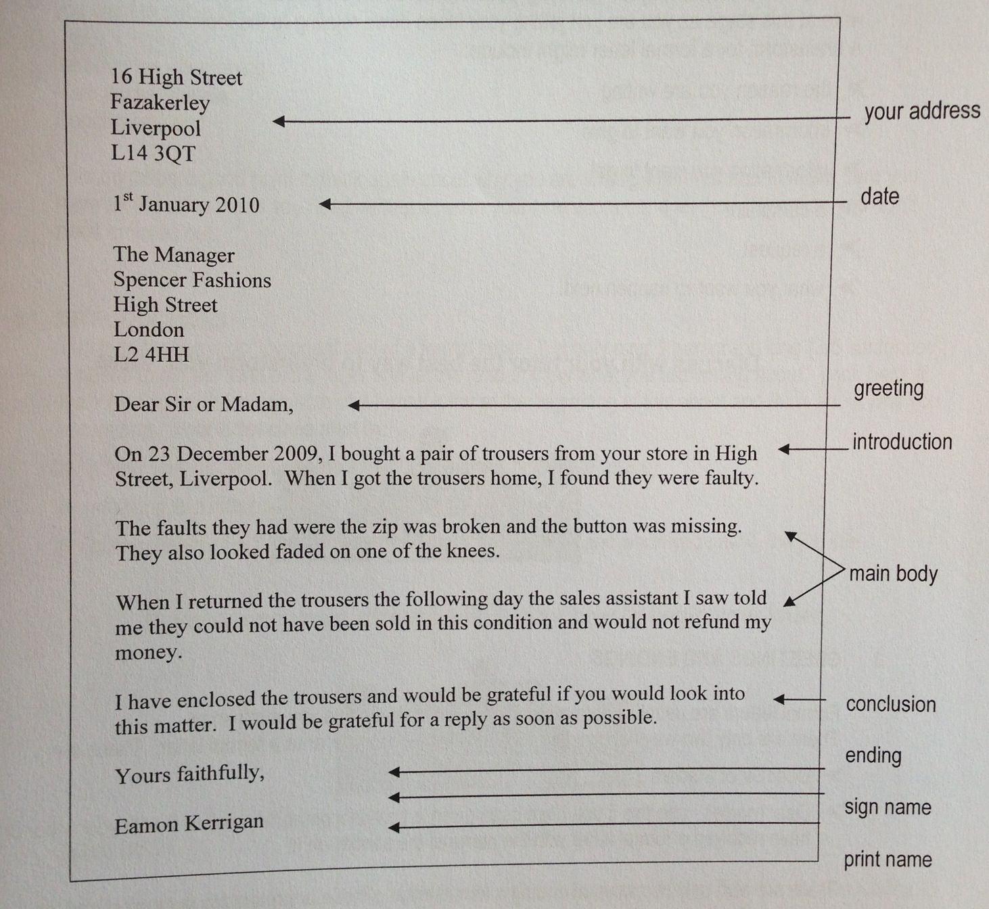
Layout

Slide 8
Brainstorming
Brainstorming is a way of getting your ideas down on paper
It doesn’t matter what you write at this stage
Just jot your ideas down about the topic

Slide 9
Formal letter brainstorm might include:
Reason you are writing
Info you want to give
Info you want to get
A complaint
A request
What you want to happen next

Slide 10
Greetings & Endings
Formal letters usually information, factual
Letters to people you don’t know
There are only 2 ways of greeting (or beginning) when you write a formal letter.
  What are they?

Slide 11
Greetings...
Dear Sir or Madam
Dear (Name)
  Use this if you have been given a person’s name who will deal with your letter or if you have received a formal letter with the name of the sender on it

Slide 12
Endings...
There are also only 2 ways of ending a formal letter.
These are related to your greeting...
What are these endings?

Slide 13
Endings...
If you use:
Dear Sir or Madam
  Always use – Yours faithfully
Dear (Name)
  Always use – Yours sincerely

Slide 14
Organising Ideas
Think about the order of your information
Decide what info to put in the:
  Introduction – beginning
  Main body – middle
  Conclusion – end
Think again why you’re writing the letter
Make sure you have all info you need written down in your brainstorm
Cross out info you don’t need from your brainstorm

Slide 15
Introductions
Important part of letter!
Only 1 paragraph long (or 3 to 5 sentences)
Needs to set the tone of the letter
Lets the reader know what you are writing about
Think about why you are writing

Slide 16
Introductions
Your letter could start by:
  Giving brief details of a complaint (e.g. product, time, date, place)
  Referring to a letter you have been sent
  Giving details of a job advert you have seen (e.g. Where and when you saw it, the job title)

Slide 17
Main Body
Brainstorm usually gives you ideas for main body
Introduction leads into these ideas
Conclusion finishes off
A way of planning your main body would be to plan what you are going to write in each paragraph
Main body in a formal letter is usually quite short and to the point

Slide 18
Letter Plan:
Introduction:
  Paragraph 1 – telling them why you are writing, details of complaint: place, date, product, fault.
Main body:
  Paragraph 2 – fault in more detail
  Paragraph 3 – what happened when item was returned
Conclusion:
  Paragraph 4 – what you want to happen next.

Slide 19
Conclusions
The end of the letter
Only 1 paragraph long (3 to 5 sentences)
To let the reader know you have definitely finished your letter
Think about what you want to say at the end

Slide 20
Thank You

